Slide 1
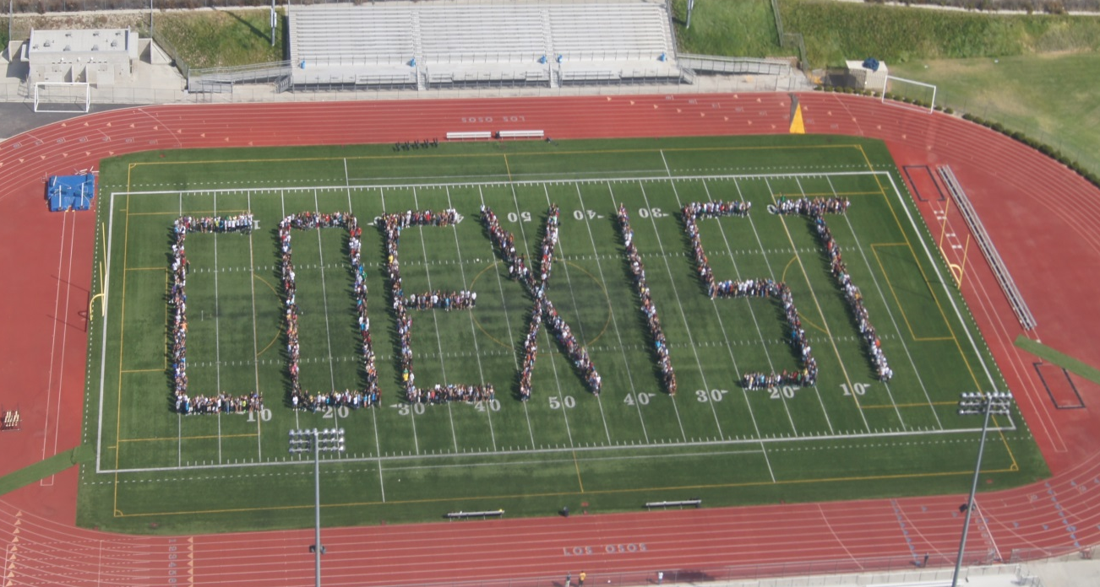
Socially Together And Naturally Diverse
STAND
“Be the change you want to see in the world”
Mahatma Gandhi
Presented by STAND Co-Founder Brian Jeffrey

Slide 2
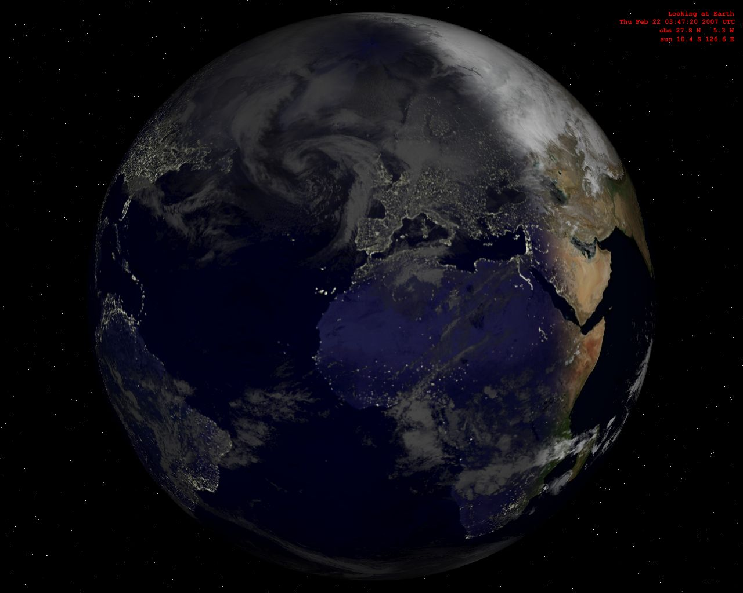

“If we could turn the population of the earth into a small community of 100 people, keeping the same proportions we have today, there would be …”

Slide 3
61 Asians
12 Europeans
8 North Americans
5 South Americans and Carribeans
13 Africans
Only 1 Oceanian
50 Men
50 Women
91 Heterosexual
9 Gay, Lesbian, Bisexual, Transgender, or Questioning
47 live in an urban area
9 are physically challenged
33 Christians (Catholics, Protestants, Orthodox, Anglicans, and other Christians)
21 Muslim
14 Hindu
9 Nonreligious
6 Buddhist
3 Atheist
1 Jewish
1 Sikh
12 other
43 live without basic sanitation
18 without an improved water source

Slide 4
6 people own 59% of world’s wealth
13 are hungry or malnourished
15 would speak Chinese (Mandarin)
7 English
6 Hindi
6 Spanish
5 Russian
4 Arabic
14 can’t read
Only 12 are educated at secondary level
12 own a computer
30 have Internet access
1 adult 15-49 has HIV/AIDS
The village spends more than $1.12 trillion on military expenditures
and only $100 billion on developmental aid world-wide
If you keep food in a refrigerator
Clothes in a closet
If you have a bed to sleep in and a roof over your head
You are richer than 75% of the entire world population
If you have a bank account, you’re one of the 30 wealthiest people in the world
18 struggle to live on $1 a day
53 on $2 a day

Slide 5

“Appreciate what you have and do your best for a better world”

Slide 6
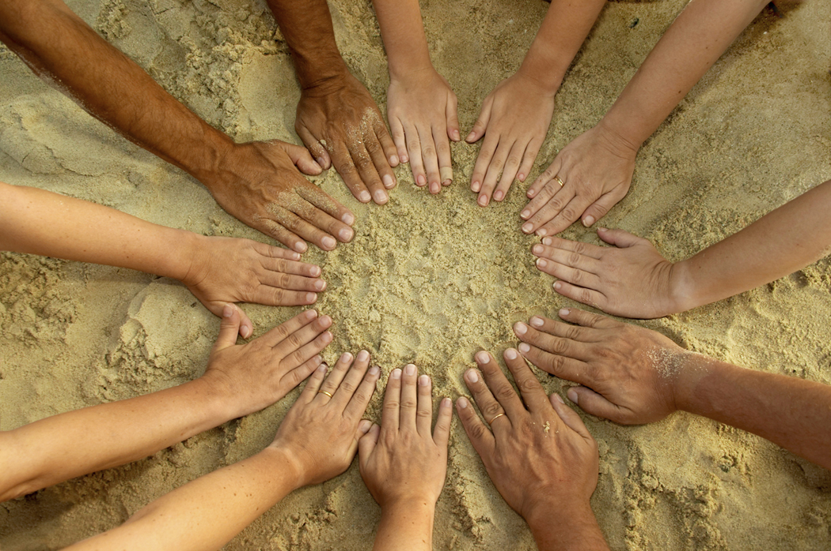
Just Like Me
Notes:
Explain that since this training is a tool to help with relationships, let’s start with a fun activity to get to know one another a little more.
Would you agree that if you were assigned to the starship “Enterprise” that it would be important to be culturally competent?

Slide 7
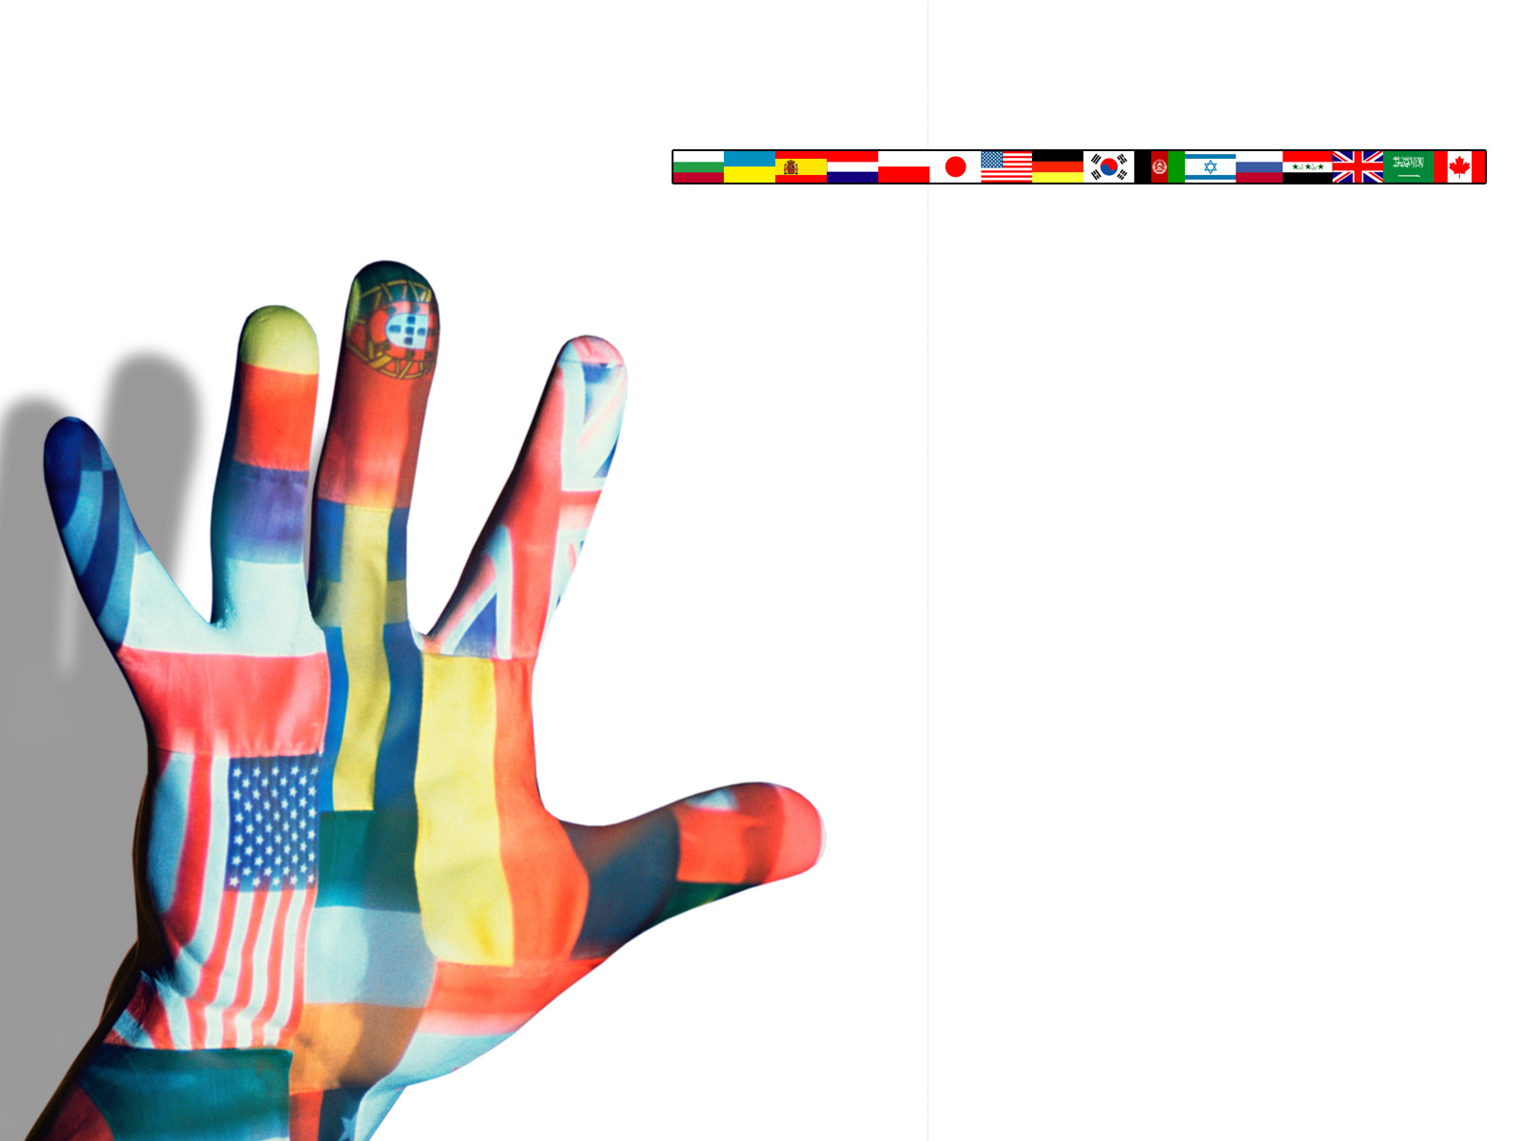
Cultural Terms
Just Like Me
English is my second language.
I am a first generation American.
I have traveled out of the United States.
I have more than two siblings.
            I have at least one parent who graduated from college.

Slide 8

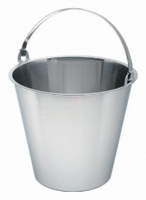

Categorization
Categorization
Race
Age
Gender
Schemas, Buckets, or
Cognitive Structures
Notes:
SCRIPT:
We are constantly bombarded with information through all of our senses, all the time. In order to make sense of all this data, our brain takes shortcuts in order to manage it. Our brains form what social scientists call “schemas” as a tool for processing incoming and new information. Schemas are connections we make between new information and prior information we already have. For our purposes, we can simply imagine schemas as buckets. Our brains are filled with tiny buckets as repositories of information. Sort of mental filing cabinets.
[Give an example of your choosing. i.e. No one needed to examine the chairs when they entered the room. No one pondered what they were or examined them for their features. Yet chairs can look very different. What are the different forms a chair can take? Have participants shout out responses. i.e. - rocking chair, recliner, office chair on wheels, modern potato chip chairs, etc. In other words, chairs can look radically different from each other. So, our brain automatically, and unconsciously, went through a mental checklist and filed it away in the bucket/schema “chair.” This then informed our behavior as we know what to do with a chair – sit.]
This process, called categorization is a fundamental social phenomenon. There is a substantial body of research in social psychology and sociology demonstrating its existence. Categorization is simply a process by which one simplifies the social environment by creating categories (schemas/buckets) based on characteristics.
The research indicates we not only categorize objects, we also categorize people. Question -- What are the 3 categories that social scientists say we automatically (and unconsciously) categorize people into?
[Table talk. Give groups a couple minutes to decide on their 3 areas. Ask groups to share. Click to advance answers on screen – race – gender – age.]
The research indicates we categorize people automatically and unconsciously into 3 categories, and in a particular order 1) race, 2) gender 3) age. What do you think? [Take a few responses] Again, this is not a conscious process, it happens automatically
[Use examples of your choosing to illustrate each category or ask for examples from participants. -- i.e. What happens when a kid is very tall for their age? Take responses. Our brains likely file them incorrectly when it comes to age. We may assume associated behaviors and expectations associated with older students such as maturity and skill level.
– i.e. Have you had the experience where you wonder “what” someone is? Many multiracial/multiethnic people say people ask them what they are. Our brain wants to automatically put them in a racial category but they are ambiguous to us. It then becomes a conscious process. Some have reported they can tell that someone has categorized them in one racial group and then once they become aware of another identity, behavior towards them change.

Slide 9

How Many Cubes
Notes:
SCRIPT:
We are constantly bombarded with information through all of our senses, all the time. In order to make sense of all this data, our brain takes shortcuts in order to manage it. Our brains form what social scientists call “schemas” as a tool for processing incoming and new information. Schemas are connections we make between new information and prior information we already have. For our purposes, we can simply imagine schemas as buckets. Our brains are filled with tiny buckets as repositories of information. Sort of mental filing cabinets.
[Give an example of your choosing. i.e. No one needed to examine the chairs when they entered the room. No one pondered what they were or examined them for their features. Yet chairs can look very different. What are the different forms a chair can take? Have participants shout out responses. i.e. - rocking chair, recliner, office chair on wheels, modern potato chip chairs, etc. In other words, chairs can look radically different from each other. So, our brain automatically, and unconsciously, went through a mental checklist and filed it away in the bucket/schema “chair.” This then informed our behavior as we know what to do with a chair – sit.]
This process, called categorization is a fundamental social phenomenon. There is a substantial body of research in social psychology and sociology demonstrating its existence. Categorization is simply a process by which one simplifies the social environment by creating categories (schemas/buckets) based on characteristics.
The research indicates we not only categorize objects, we also categorize people. Question -- What are the 3 categories that social scientists say we automatically (and unconsciously) categorize people into?
[Table talk. Give groups a couple minutes to decide on their 3 areas. Ask groups to share. Click to advance answers on screen – race – gender – age.]
The research indicates we categorize people automatically and unconsciously into 3 categories, and in a particular order 1) race, 2) gender 3) age. What do you think? [Take a few responses] Again, this is not a conscious process, it happens automatically
[Use examples of your choosing to illustrate each category or ask for examples from participants. -- i.e. What happens when a kid is very tall for their age? Take responses. Our brains likely file them incorrectly when it comes to age. We may assume associated behaviors and expectations associated with older students such as maturity and skill level.
– i.e. Have you had the experience where you wonder “what” someone is? Many multiracial/multiethnic people say people ask them what they are. Our brain wants to automatically put them in a racial category but they are ambiguous to us. It then becomes a conscious process. Some have reported they can tell that someone has categorized them in one racial group and then once they become aware of another identity, behavior towards them change.

Slide 10



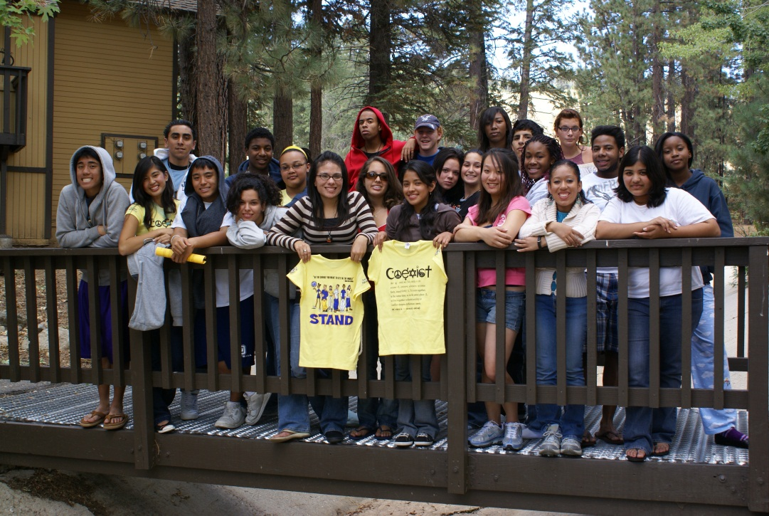


S^{ocially} T^{ogether} A^{nd} N^{aturally} D^{iverse}
STAND is an acronym for Socially Together And Naturally Diverse.
STAND was founded in 1990 at Etiwanda High School as a means of bringing together students from diverse cultural backgrounds to fight racism, prejudice, and bullying while promoting strength through diversity.
STAND’s “Declaration of Beliefs” was created in cooperation with the United States government’s Department of Justice in 1991.
STAND is represented on campuses nationwide and combats the spread of racism and all forms of prejudice as it promotes multicultural harmony, education, acceptance, and respect.
At schools across the country, STAND unites diverse students, cultural clubs, and performing groups under its banner.

Slide 11
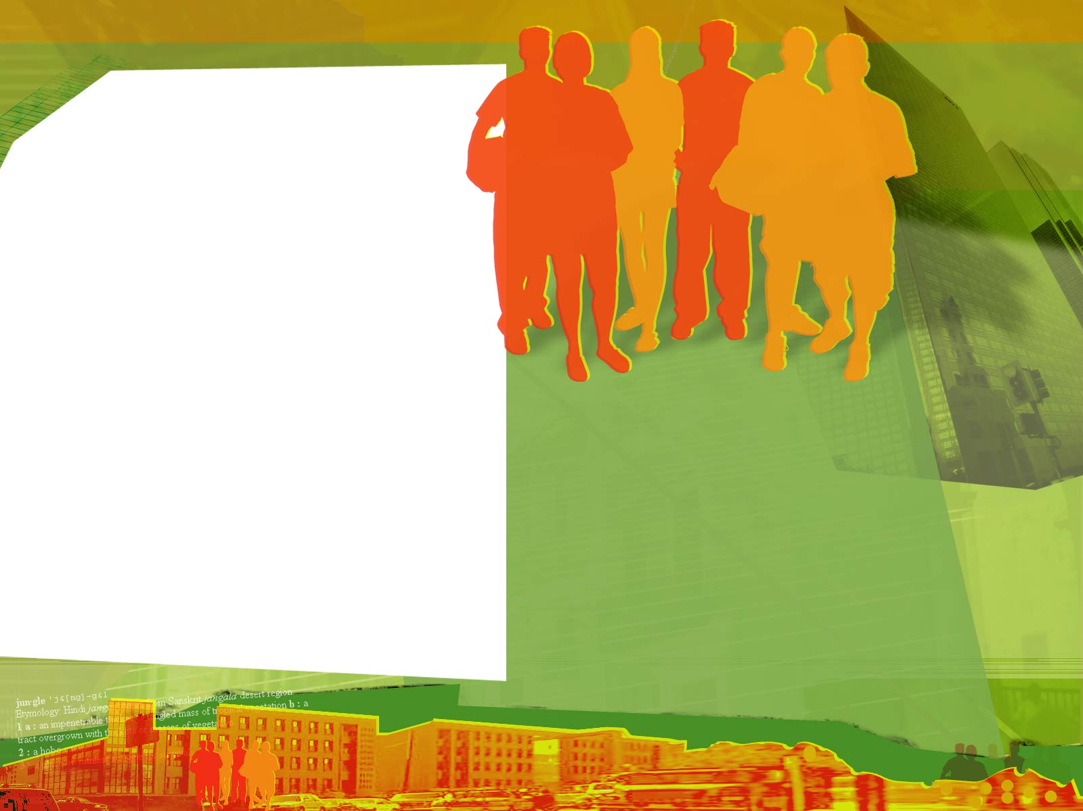
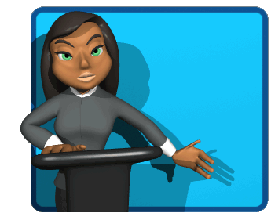
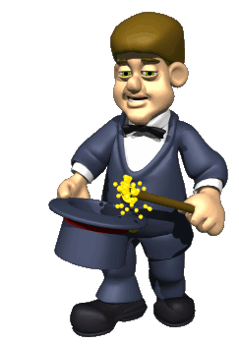
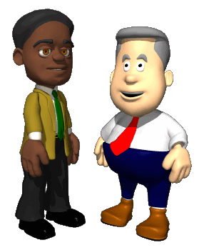
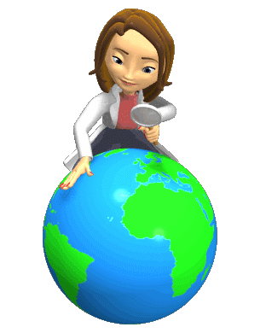
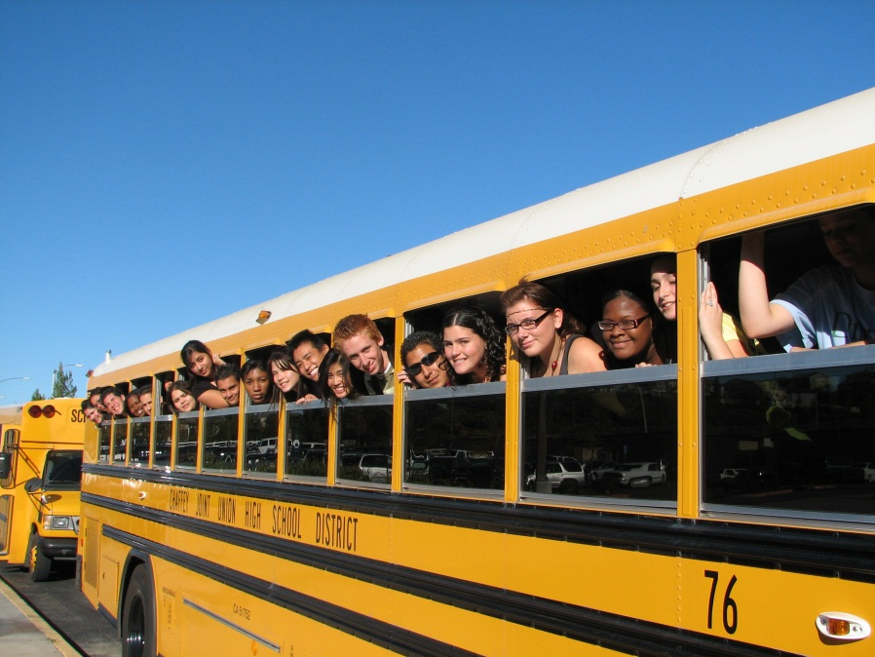
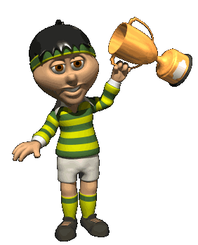
Starting a STAND Multicultural Club at Your School
How does STAND promote diversity, tolerance, anti-bullying, and multicultural acceptance on campus?
STAND gives diverse students a reason to be together!
STAND trains students on how to handle diversity adversity!
STAND helps make your campus a unity community!
STAND has received human rights awards from the the NEA, CTA, and the YWCA, as well as community awards by USA Network, KNBC News, the L.A. Times, and the Rancho Cucamonga City Council.

Slide 12
S^{ocially} T^{ogether} A^{nd} N^{aturally} D^{iverse}
Download the STAND Chapter Membership Booklet from joinstand.com
Choose diverse student leaders to become part of STAND’s leadership team
Offer the UC and CSU approved class “American Mosaic”
Each month, present fun cultural activities, post multicultural unity posters, as well as publish a cultural newsletter or newspaper that celebrates diversity
Throughout the year, have STAND leadership students plan class presentations, diversity workshops, as well as cultural field trips, college tours, and sponsor anti-bullying assemblies.

Slide 13
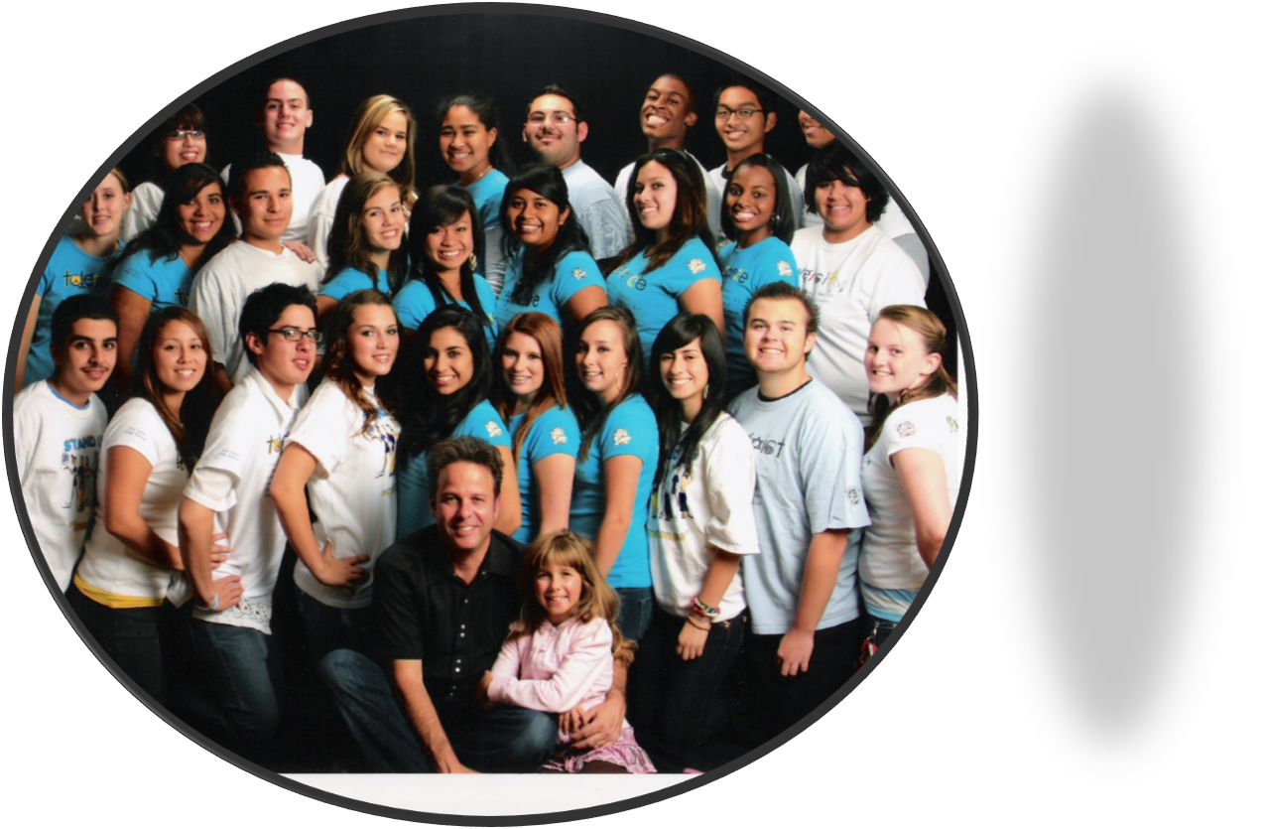
Sample STAND Activities and Celebrations
STAND Retreat
Spell COEXIST with Students on Field
Native American Celebration on Columbus Day
STAND Cultural Meetings
Anti-Bullying Rally
Oktoberfest Celebration
Maypole Activity
Belly Dancing Performance
Cultural Arts Night
St. Patrick’s Day Celebration
Cinco de Mayo Celebration
Polynesian Dance Performance
Dr. Martin Luther King, Jr. Celebration
Aztec Dancers on Dia De Los Muertos
American Mosaic Offered As a Class or CCSS Unit(s)
STAND Banquet

Slide 14

Using the ROPES to Untie the Knots
ROPES has proven successful in creating a positive environment in which to conduct emotionally charged meetings.
Respect: We must respect each other regardless of differing perspectives.
Openness: We must feel free to be open and honest without fear of being shouted down.
Participation: We must allow all who want to participate the opportunity to do so without letting one or two people dominate the discussion.
Encouragement: We must encourage one another to find common ground so solutions to the issues being discussed can be reached.
Safety: We must feel free from any harm in expressing beliefs with which we disagree.

Slide 15
Cultural Alphabet Soup
Race: An artificial classification of people by skin color or geographical location. There is only one race: human.
Ethnicity: A person’s heritage. Not to be confused with a person’s race. Examples of ethnicity are Mexican, Nigerian, Vietnamese, German, Arabic etc. In America, most people claim a heritage that identifies more than one ethnic group.
Culture: A combination of a person’s heritage, ethnicity, race, language, religion, and traditions.
Nationality: A person who is a citizen of a country by birth or naturalization, not to be confused with a person’s ethnicity or heritage.
Notes:
Ask the question on the slide: What is the #1 reason that high school students give for doing well in school?
Have participants share their thoughts. Take two or three comments.

Slide 16
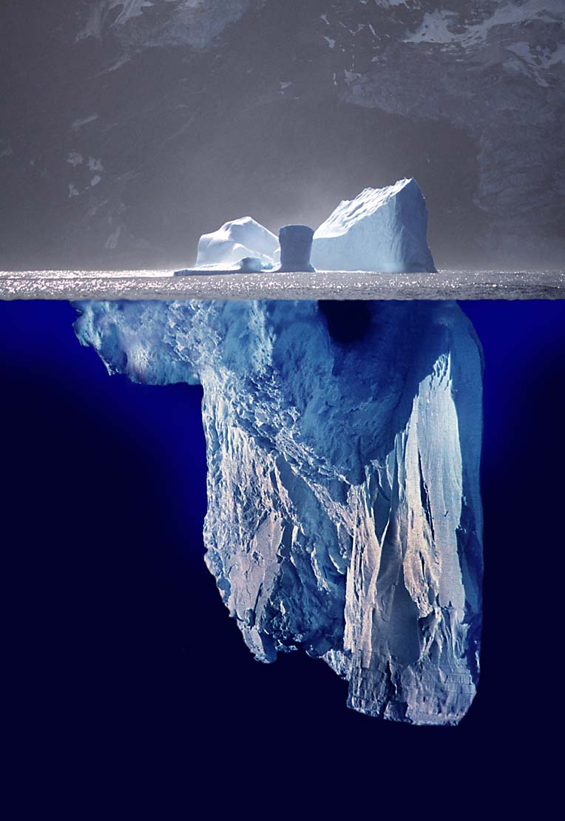
Cultural Iceberg: A Better Understanding
Visible
Gender
Diversity means all the ways we differ. It includes the readily visible differences and the underlying invisible differences that may be below the surface.
Visible
Physical Attributes
Ethnicity
Language
Visible
Age
Food
Customs
Attitudes
Values
Religion
Sexual Orientation or Identity
Education
Heritage
Family Status
Invisible
Life Experiences
Beliefs
Skills
Perspectives
Notes:
As you can see, “what is visible”, just as with the iceberg, gives us some information about a person, however, “what is invisible”, that which we do not see, is information that helps us to get to know the individual.
Too often, we make assumptions about a person based on what is visible and how that information fits in our stereotyping.
When we interact with people and listen to them, we learn more about how unique they are.

Slide 17


What is the number one reason that all students give for doing well in school?
Question:
Notes:
Ask the question on the slide: What is the #1 reason that high school students give for doing well in school?
Have participants share their thoughts. Take two or three comments.

Slide 18
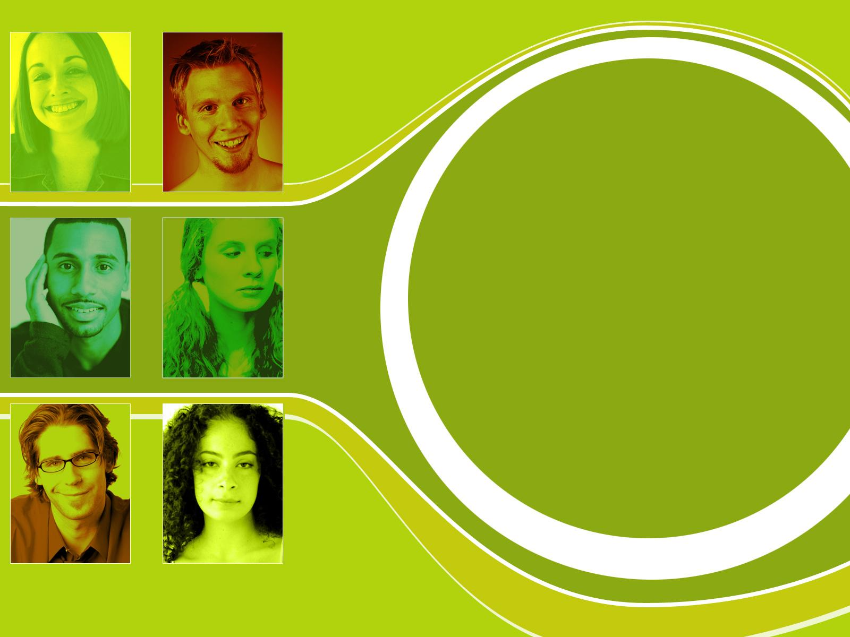
Answer:
Students say, “Having a caring, supportive and positive relationship with a teacher… motivates me to do well in school.”
Source: The Silent Epidemic: Perspectives of High School Dropouts, Bill & Melinda Gates Foundation, 2006

Slide 19
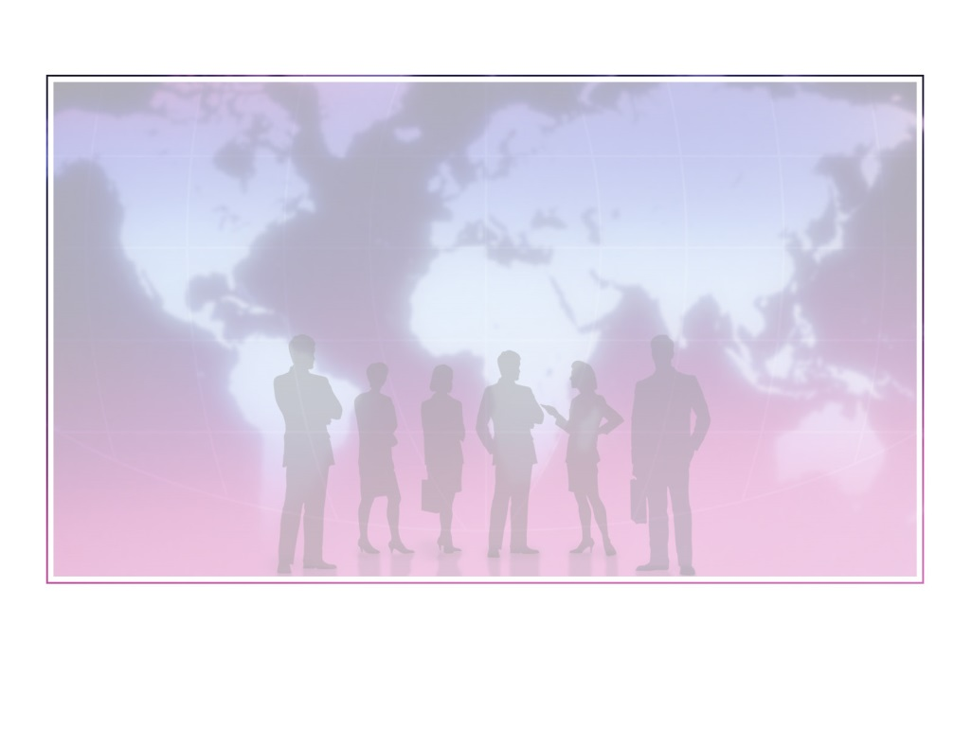
Examining Your School’s Diversity Quotient
1. Teachers and administrators have positive attitudes, beliefs, and perceptions of ethnic, GLBTQ, and non- Christian students.
2. The formalized curriculum reflects the experiences, cultures, and perspectives of a range of cultural and ethnic groups.
3. Teaching styles used by the teachers match the learning styles of the students.
4. The school (teachers, administrators, etc.) show respect for the students’ first languages and dialects.
5. Instructional materials used in the school show events, situations, and concepts from the perspective of a range of cultural, ethnic, and religious groups.
Honestly Rate Your School on a Scale of 1 to 5
(with 5 being highest)

Slide 20
Examining Your School’s Diversity Quotient
6. Assessment and teaching procedures used in the school are culturally sensitive and result in socio-economic students being represented proportionally in all classes.
7. The school’s culture and hidden curriculum (as evidenced by the ethnic composition of the staff, bulletin boards, etc.) reflects cultural, religious, and socio-economic diversity.
8. Adults in the school have high expectations for ethnic and diverse students by helping them set positive career goals.
9. There are cross-cultural organizations on campus that offer students from all cultural, ethnic, and religious groups an opportunity to interact with one another.
Honestly Rate Your School on a Scale of 1 to 5
(with 5 being highest)

Slide 21
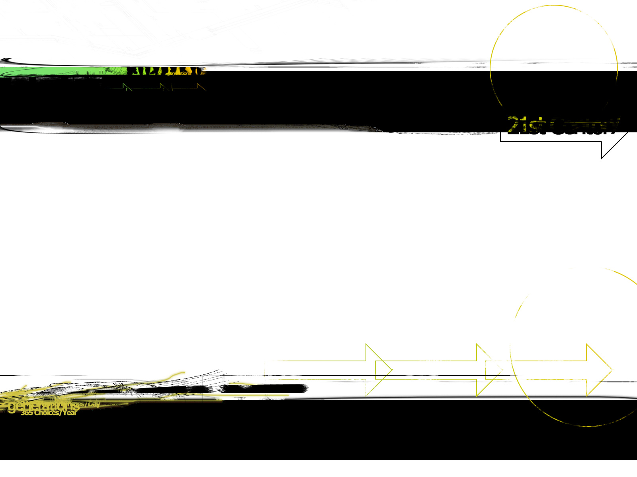

The 411 on GLBTQ 101
GLBTQ is shorthand for Gay, Lesbian, Bisexual, Transgender, and Questioning
Creating the hate-free zone
Think, Pair, Share: What does “hate-free” mean?
So, what’s acceptable, what’s not?

Slide 22

Making Your Class a Safe Zone
What Does the Ed Code Say?
    AB 537 (The California Student Safety and Violence Protection Act of 2000)
    Protects students, faculty, and staff at public schools (and non-religious schools receiving funding) from harassment and discrimination on the public basis of actual or perceived sexual orientation and gender identity.

Slide 23
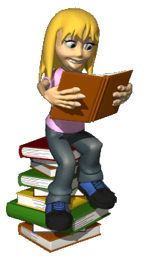
Time to Do Some Homework!
Interrupt anti-GLBTQ jokes, comments, or any other behaviors that make homophobia appear acceptable
Always use neutral labels like "significant other" or "partner" instead of just "boyfriend" or "girlfriend" when talking with colleagues and students or writing in class
Address GLBTQ issues when talking with colleagues or students
Put diversity, inclusion, and anti-bullying posters in the halls and classrooms or wear shirts or buttons that promote value
11/5/2013
Notes:
CATE 2009
Presenter: Brian Jeffrey
23
Website: mrjeffrey.com E-Mail: mrj@mrjeffrey.com

Slide 24
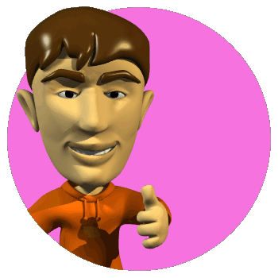
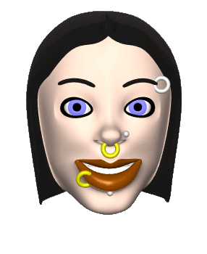
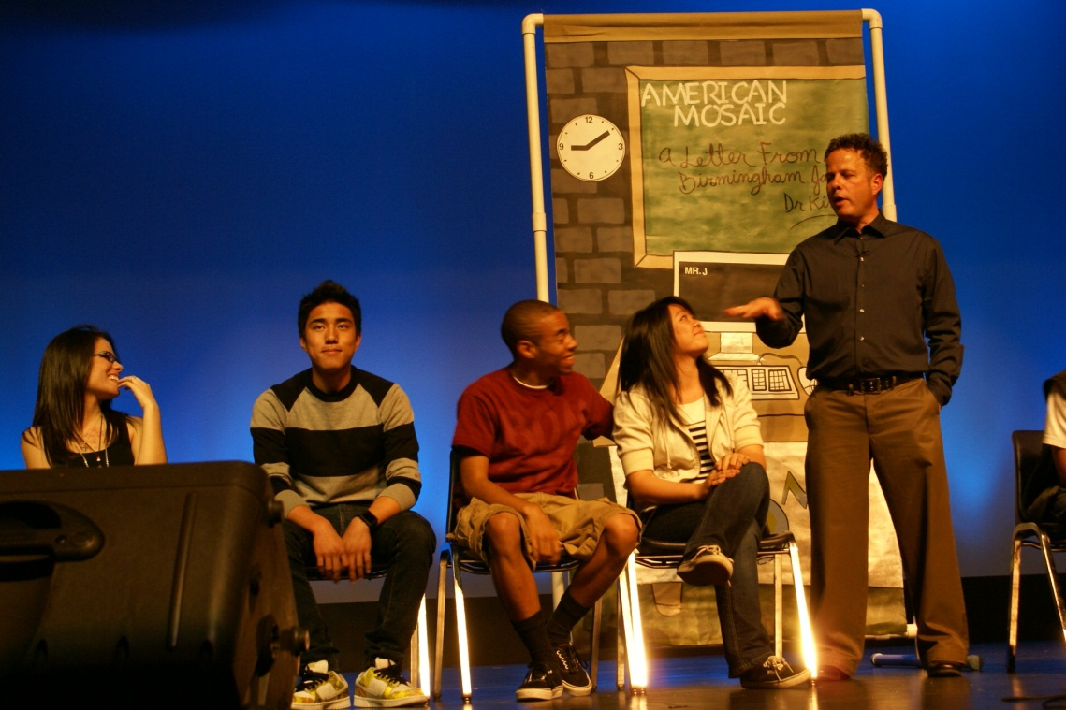
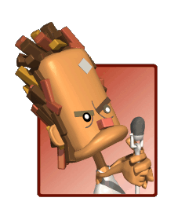
Where are we now, and how can STAND help?
In an age of standardized tests and API scores, diversity has taken a seat at the back of the school bus.
Unless we are proactive, we face criticism for being reactive to the next racial, cultural, and bullying emergency.
To thrive as a school, we must embrace and promote the value of diversity through acceptance.

Slide 25
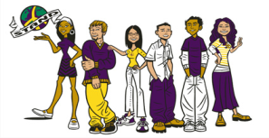
So…
What steps can we take today to start a STAND chapter at my school tomorrow?
Make it Better

Slide 26

“That’s Not My Job”
This is a story about four people named Everybody, Somebody, Anybody, and Nobody.
There was an important job to be done and Everybody was sure that Somebody would do it.
Anybody could have done it, but Nobody did it.
Somebody got angry about that because it was Everybody’s job.
Everybody thought Anybody could do it.
But realized that Everybody wouldn’t do it.
It ended up that Everybody blamed Somebody when Nobody did what Anybody could have!

Slide 27
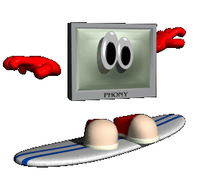
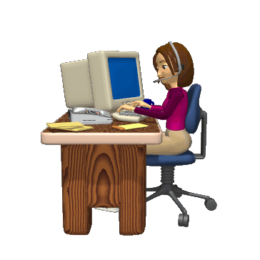

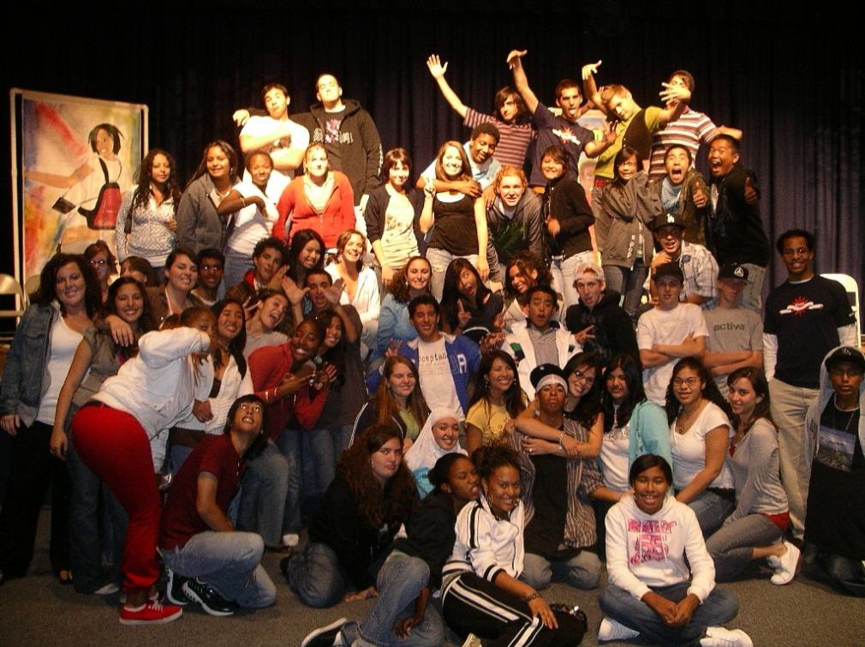



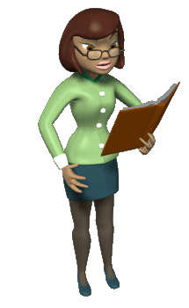
Contact Information
Internet: joinstand.com
E-mail: mrj@mrjeffrey.com
    Contact: Brian Jeffrey
Phone: (909) 621-6781
Cell: (909) 553-9392
Fax: (909) 391-5323
    YouTube Channel:
        myvirtualteacher
California Teachers Association
    Contact: Phyllis Peters
    ppeters@cta.org

Slide 28
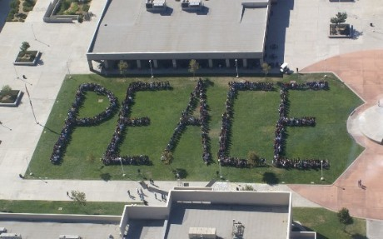
Socially Together And Naturally Diverse
STAND
“Be the change you want to see in the world”
Mahatma Gandhi
Presented by STAND Co-Founder Brian Jeffrey
Notes:
Tolerance gets us laws: values change a culture.
Reena Doyle

